Slide 1
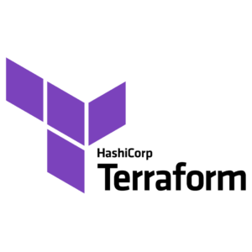
TERRAFORM PROJECT
By:
Mohammed firasat sayeed

Slide 2
Introduction:-
Terraform is an Infrastructure as code (Iac) software.
It is an open-source software created by Hashicorp.
Infrastructure as code is the process of managing infrastructure in a file rather than manually configuring resources in a user Interface.
Terraform supports most of all cloud providers (AWS, AZURE,GCP…).
To create resources we write terraform scripts, by using terraform scripts we can set up the infrastructure of the project.
Terraform is a powerful and flexible tool that enables users to define and manage infrastructure resources in a reusable and automated way.

Slide 3
TERRAFORM LANGUAGE:
The main purpose of the Terraform language is to declare resources , which represent infrastructure objects.
The configuration files are written in the HashiCorp Configuration Language (HCL), which is a domain-specific language designed specifically for Terraform.
A Terraform configuration is a complete document in the Terraform language that tells Terraform how to manage a given collection of infrastructure.
The syntax of the Terraform language consists of only a few basic elements:
Eg:- creating a vpc for project. <Block Type> “<Block Label>” “<Block label>”{
resource “aws_vpc” “my-vpc” #Block body
cidr_block = “10.0.0.0/16” <IDEBTIFIER> = <EXPRESSION> #ARGUMENT
} }

Slide 4
Blocks are containers for other content and usually represent the configuration of some kind of object, like a resource. Blocks have a block type, can have zero or more labels, and have a body that contains any number of arguments and nested blocks. Most of Terraform's features are controlled by top-level blocks in a configuration file.
Arguments assign a value to a name. They appear within blocks.
Expressions represent a value, either literally or by referencing and combining other values. They appear as values for arguments, or within other expressions.

Slide 5
TERRAFORM EXECUTION FLOW:-
Terraform version : To check the version of Terraform
Terraform Init : To Initialize the terraform directory
Terraform fmt : To assign the proper format of the script
Terraform validate : To validate the terraform script and configuration
Terraform plan : To show the changes going to take place
Terraform apply : To create and update Infrastructure
Terraform show : To show the current state or saved plans
Terraform refresh : To sync with GUI & CLI with state file
Terraform destroy : To destroy previously created Infrastructure

Slide 6
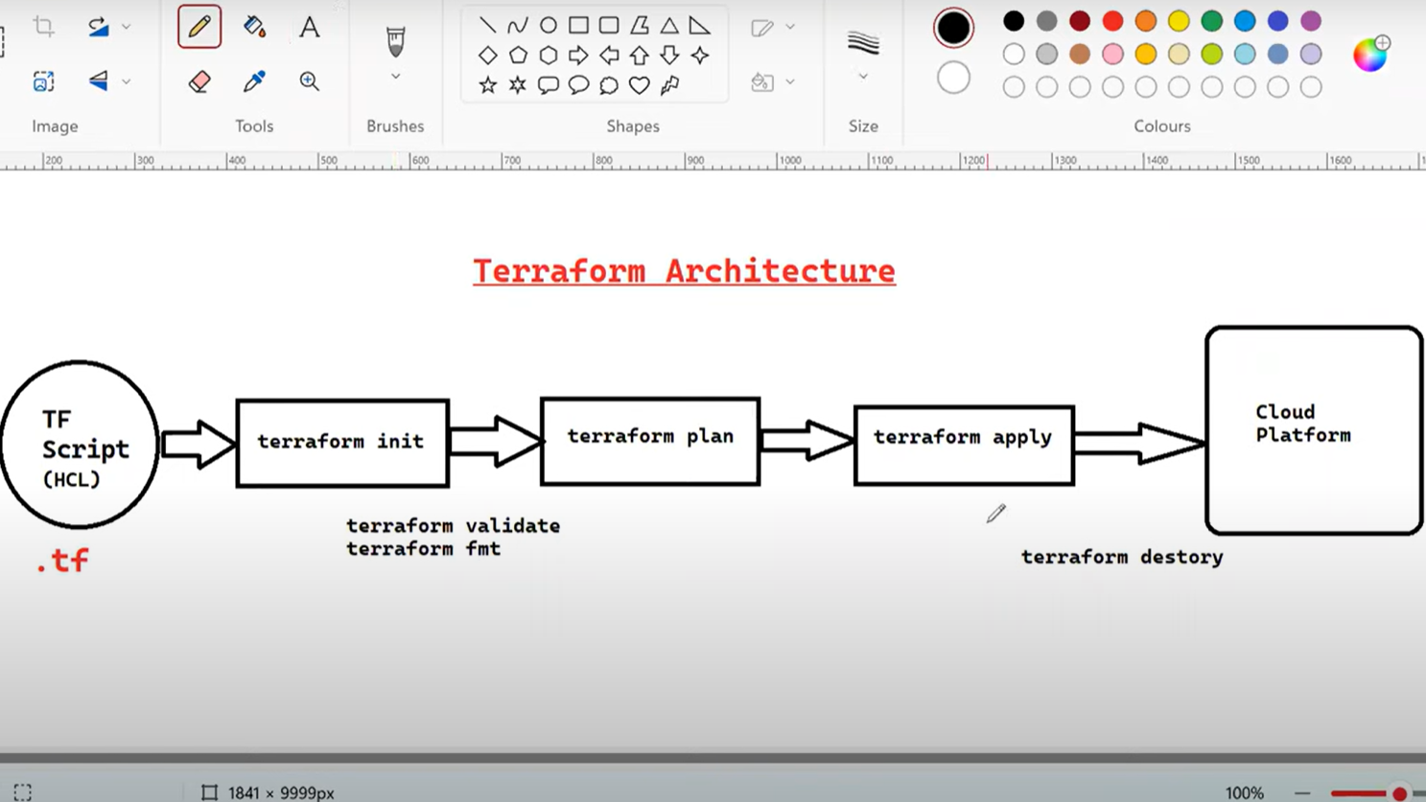
Terraform architecture:-

Slide 7
TERrAFORm WORKFLOW:-WRITE PLAN APPLY .
Write: Write the terraform code and save it in any versioning system such as GitHub.
Plan: continuously add and review the changes before actually Deploy.
Apply: After reviewing the changes at the final time, you can provision the Infrastructure or make the modification.

Slide 8
THANK YOU

